Slide 1




Cloud Services
http://clouddevcourse.telerik.com
Storage, Notifications, Queues, Background Tasks, Email, CDN, Logging, Caching, MapReduce, …
Cloud
Svetlin Nakov
Services
Telerik Software Academy
academy.telerik.com

Slide 2










Table of Contents
Storage Services
Message Queues
Notification Services
Email Delivery
Content Delivery Networks (CDN)
Logging Services
Caching Services
Background Tasks
MapReduce Calculations
Other Cloud Services

Slide 3



Cloud Storage Services
Introduction

Slide 4
Cloud Storage Services
Cloud Storage Services are public infrastructure for storage of large objects
Files / blobs / images / videos / etc.
Stored in Internet (in a public cloud)
Accessible through some API (REST / SDK / etc.)
May have front-end for end-user access
Could support access control list (ACL)
Could be free (with limits) or paid (on-demand)
Could support CDN delivery or not

Slide 5
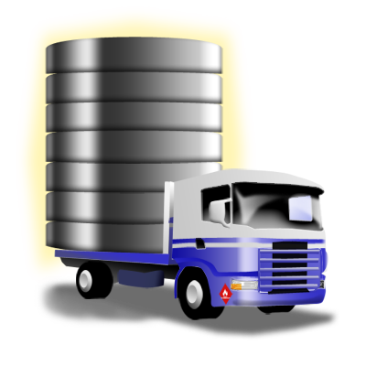
Cloud Storage Services – Examples
Amazon S3
Google AppEngine Blobstore
Google Cloud Storage
Azure Blobs
Rackspace Cloud Files
Google Drive, Microsoft SkyDrive, Apple iCloud
Dropbox, Box.com, ADrive, Mozy, FlipDrive, SpiderOak, SugarSync

Slide 6

Amazon S3
S3 == Simple Storage Service

Slide 7
Amazon S3
Amazon S3 == Simple Storage Service
On-demand file storage in the AWS cloud
Highly-reliable (99.999999999% durability and 99.99% availability)
Many APIs: RESTful / SOAP / C# / Java / others
Two modes:
Normal – more reliable, more expensive
Reduced redundancy – cheaper, but less reliable
Multiple locations: US, Europe, Asia

Slide 8
Amazon S3 Concepts
Your cloud storage consists of buckets
Objects are stored in the buckets
Object
Object
Object
Bucket
Bucket
Bucket
Nakov-at-home.jpg
MyCat.avi
Sample.mp3
music/mp3/Demo.mp3

Slide 9
Amazon S3 Pricing
Amazon S3 Pricing (as of August 2013)
http://aws.amazon.com/s3/pricing/
 | Standard Storage | Reduced Redundancy Storage | Glacier Storage
First 1 TB / month | $0.095 per GB | $0.076 per GB | $0.010 per GB
Next 49 TB / month | $0.080 per GB | $0.064 per GB | $0.010 per GB
Next 450 TB / month | $0.070 per GB | $0.056 per GB | $0.010 per GB
Next 500 TB / month | $0.065 per GB | $0.052 per GB | $0.010 per GB
Next 4000 TB / month | $0.060 per GB | $0.048 per GB | $0.010 per GB
Over 5000 TB / month | $0.055 per GB | $0.037 per GB | $0.010 per GB

Slide 10
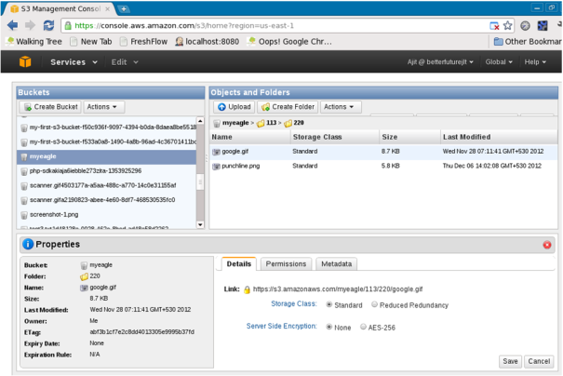
Amazon S3 in AWS Console

Slide 11
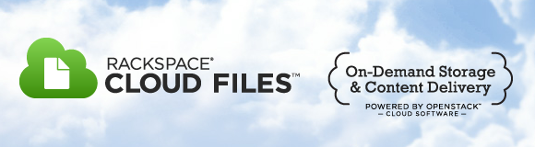
Rackspace Cloud Files
File Storage in the Cloud Served through a CDN

Slide 12
Rackspace Cloud Files
Rackspace Cloud Files
Cloud storage service by Rackspace
Can use Akamai CDN
RESTful API / Java API / C# API / PHP API / …
Main operations
List containers, list objects, CRUD for objects
Pricing (as of August 2013)
On-demand: $0.10 / GB per month
Akamai CDN: $0.12 / GB

Slide 13

Dropbox
Cloud Storage with Auto Sync for Any Device Accessible through REST / Java / C# APIs

Slide 14
Dropbox
Dropbox
File storage in the Dropbox cloud
2 GB free + bonus storage (up to 18 GB)
Auto-sync for any device / OS
Windows, Mac OS X, Linux
iPhone, iPad, Android
Accessible through REST / Java / C# APIs
www.dropbox.com/developers/reference/sdk

Slide 15

Accessing Dropbox from .NET through OAuth
Live Demo

Slide 16
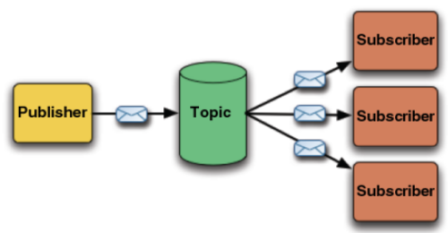
Queues in the Cloud
Message Queues, Publish-Subscribe Model, Asynchronous Messaging

Slide 17
Queues and Messaging
Message queues are mechanism for asynchronous message delivery
Publish-subscribe model
Topics are available for subscription
Also known as message channels
Publishers send messages to some topic
Subscribers receive messages asynchronously

Slide 18
Message Queue Cloud Services
Many public cloud platforms provide message queue services in the cloud
IronMQ – iron.io/products/mq
Has free and paid plans (no credit card required)
Supports all major languages (C#, Java, PHP, …)
CloudAMQP – cloudamqp.com
RabbitMQ as a service (has free and paid plans)
Supports all major languages (C#, Java, PHP, …)
Amazon SQS – paid service (free trial)
Azure Queue Service – paid service (free trial)

Slide 19

IronMQ
Live Demo

Slide 20





Notification Services
Client Device
Server Application
Notification Service
Client Device
Client Device
Push Notifications in the Cloud

Slide 21
Push Notifications
What does "push notifications" mean?
Push notifications are a mechanism to instantly deliver asynchronously messages
To subscribed client applications or devices
E.g. iPhone app / Android app / Windows 8 app / JavaScript Web app (HTML5)
Client Device
Server Application
Notification Service
Client Device
Client Device

Slide 22
Cloud Notification Services
Apple Push Notification Service (APNS)
Delivers push notifications for iOS (iPhone / iPad)
A free public service hosted by Apple in their cloud
Accessed through TCP socket to gateway.push.apple.com:2195 (over TLS)
Windows Push Notification Services (WNS)
Delivers push notifications for Windows 8 devices
A free public service hosted by MS in their cloud
Accessed though HTTPS connection to https://db3.notify.windows.com

Slide 23
Cloud Notification Services (2)
Android Cloud to Device Messaging Framework (C2DM)
Push notification service for Android devices
Similar to iOS APNS and Win8 WNS
Hosted by Google in their cloud, free
Google AppEngine Channel API
Push notifications to JavaScript applications
Standard service in Google AppEngine (GAE)
Has Java and Python API (no C# / PHP / Ruby)

Slide 24
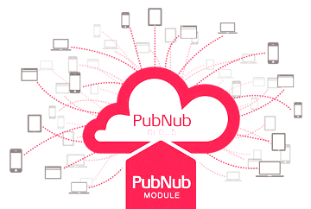
Cross-Platform Push Notifications
Cross-platform push notification clouds unify the push messaging across platforms and devices
Send push messages through any language (like C#, Java and PHP)
Receive the messages in any device / app
iOS, Android, WP7, Windows 8, JavaScript
PubNub – www.pubnub.com
Has free and paid subscriptions
SDK for C# / Java / PHP / …
Client for iOS, Android, WP7, HTML5, Flash

Slide 25

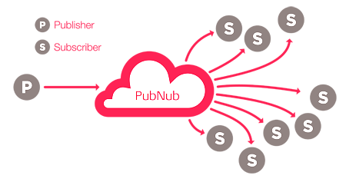

PubNub
Live Demo

Slide 26




Email Delivery Services
Send / Receive Email Services for Cloud Apps

Slide 27
Email Delivery Cloud Services
Many email delivery cloud services are provided as add-ons in most public clouds
Mailgun
Send / receive emails (POP3 and IMAP inboxes)
Free 300 emails per day + paid plans
SendGrid
Email delivery + analytics
Free 200 emails per day + paid plans
CloudMailIn
Incoming emails to HTTP hook

Slide 28

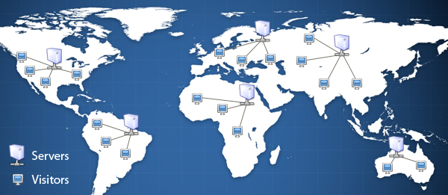
Content Delivery Networks (CDN)
Fast Deliver Content from Multiple Geo-Locations

Slide 29
Content Delivery Networks
Content Delivery Networks (CDN) are content-storage and distribution networks
Speed-up access to files / images / videos
Reduce the load of a central server
Mirror the content across many nodes in different geo-locations (e.g. one per region)
Each node keeps a cached copy of the most-requested files
Could host public and private files
Usually provides SCP / FTP file access + API

Slide 30
Cloud CDN Services
Akamai CDN – www.akamai.com
The largest and most mature CDN (leader)
Pricing
~ $0.40/GB, less for high volume
Rackspace Cloud Files
Cloud storage + CND (based on Akamai)
Pricing (as of June 2012)
~ $0.10/GB/month for the storage
~ $0.40/GB for the traffic in the CDN

Slide 31
Cloud CDN Services (2)
Amazon CloudFront CDN
Used as extra to Amazon S3 and EC2
Costs ~ $0.12/GB – $0.25/GB for the traffic
Windows Azure CDN
Used as extra for the Windows Azure Storage
Charges ~ $0.12 /GB for US to Europe transfers
MaxCDN – www.maxcdn.com
Seems less expensive
~ $0.02/GB-$0.07/GB (min 1 TB traffic for $40)

Slide 32
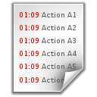




Logging Services
Log Management, Analytics, Alerts, Etc.

Slide 33
What is Logging?
Logging is chronological and systematic record of data processing events in a program
E.g. the Windows Event Log, Apache access log
Logs can be saved to a persistent medium (locally or in the cloud) to be analyzed later
Cloud logging services usually provide:
Storage of logs messages
Analytics (find / explore / visualize)
Alerts (e.g. send email / SMS on certain errors)

Slide 34

Cloud Logging Services
Logentries – logentries.com
Real-time logging service
Log analysis & visualization, events tracking
Free plan: 1 GB log / month, 1 week analytics
Loggly – loggly.com
System monitoring and alerting
Application intelligence (analytics)
RESTful API + libraries for Java, C#, PHP, …
Free plan: 200 MB log + 1 week analytics

Slide 35
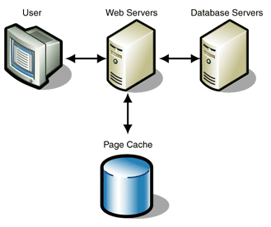
Caching Services
Caching Data for Faster Subsequent Access

Slide 36
Caching Services
Caching means to store data in memory or in other fast storage for faster later access
E.g. instead of building a Web page (3-4 SQL queries + some processing), get it from the cache
The cache holds data objects (key-value pairs)
Cached data has expiration (e.g. 5 minutes)
Usually runs locally in the cloud provider
AppHarbor runs Membase Memcached Server
Heroku runs Memcached Server (Couchbase)
Free plans (5 MB) + paid plans

Slide 37
Cloud Caching Services
AppHarbor Memcacher
Accessed through Enyim MemcachedClient
5 MB free cache storage + paid plans
Heroku Memcache
Accessed through client libraries: MemcachedClient for Java / Python / Ruby
5 MB free cache storage + paid plans
MemCachier for Heroku – memcachier.com
25 MB free cache + paid plans

Slide 38

Background Tasks
Run Background Server-Side Logic

Slide 39
Background Tasks in the Cloud
Google AppEngine Task Queue API
Perform work as background processing
Based on URL invocation with parameters
GAE asynchronously executes HTTP post to a preconfigured URL for each task in the task queue
Heroku Scheduler
Runs tasks on certain time (e.g. 10 minutes)
Heroku Cron
Daily Cron – runs a task once daily (free)
Hourly Cron – runs a task every hour (paid)

Slide 40
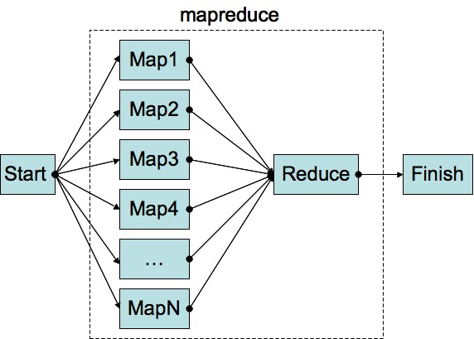
MapReduce Calculations
Distributing Large Calculations on Multiple Machines

Slide 41
What is MapReduce?
MapReduce is distributed calculation paradigm
Splits a long calculation to multiple nodes
The results is calculated many times faster
The consumed resources are many times more
Application of "map reduce"
For time-consuming computational tasks
E.g. encoding a video, data compression, generating a very complex report
MapReduce infrastructure is provided as service in many public clouds

Slide 42
MapReduce in the Public Clouds
Amazon Elastic MapReduce (Amazon EMR)
MapReduce API running in the AWS infrastructure – uses EC2 and S3
Cost = EMR price + EC2 price + S3 price
Google AppEngine MapReduce Service
Has Python and Java APIs
Priced like usual GAE computing instances

Slide 43

Other Cloud Services

Slide 44
Other Cloud Services
The best way to learn about the other public cloud services is to explore the
Add-Ons Directory on Heroku
https://addons.heroku.com
A really large list of cloud add-ons

Slide 45
Other Cloud Services
http://academy.telerik.com

Slide 46
Homework
Implement a very simple chat application based on some message queue service:
Users can send message into a common channel.
Messages are displayed in the format {IP : message_text}.
Use a language, cloud and message queue service of your choice (e.g. C# + AppHarbor + IronMQ). Your application can be console, GUI or Web-based.
Re-implement the application using the PubNub API.
Write a C# program to publish a photo album with few photos into DropBox and share the photos through the Dropbox sharing functionality.

Slide 47



Free Trainings @ Telerik Academy
"Software Development in the Cloud" Course @ Telerik Software Academy
clouddevcourse.telerik.com
Telerik Software Academy
academy.telerik.com
Telerik Academy @ Facebook
facebook.com/TelerikAcademy
Telerik Software Academy Forums
forums.academy.telerik.com

